Slide 1
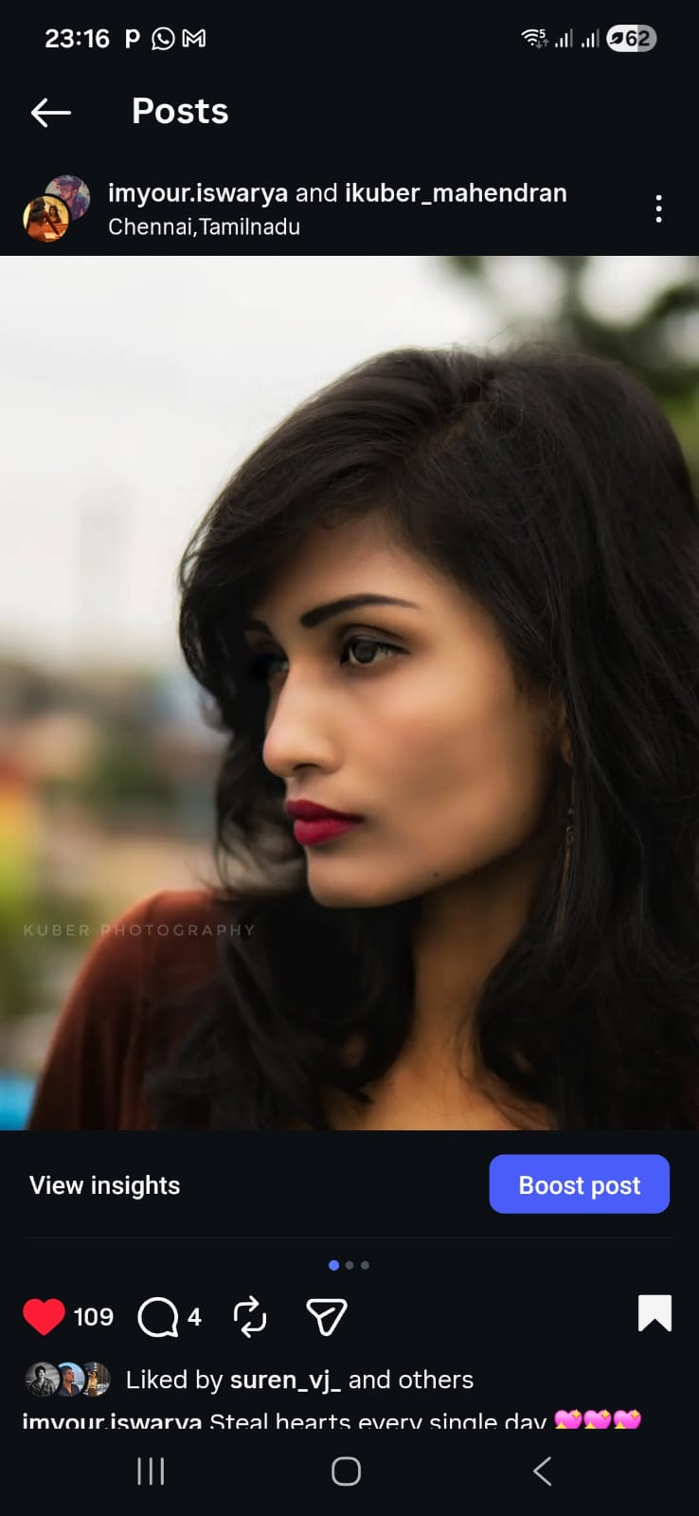
Iswarya S

Slide 2
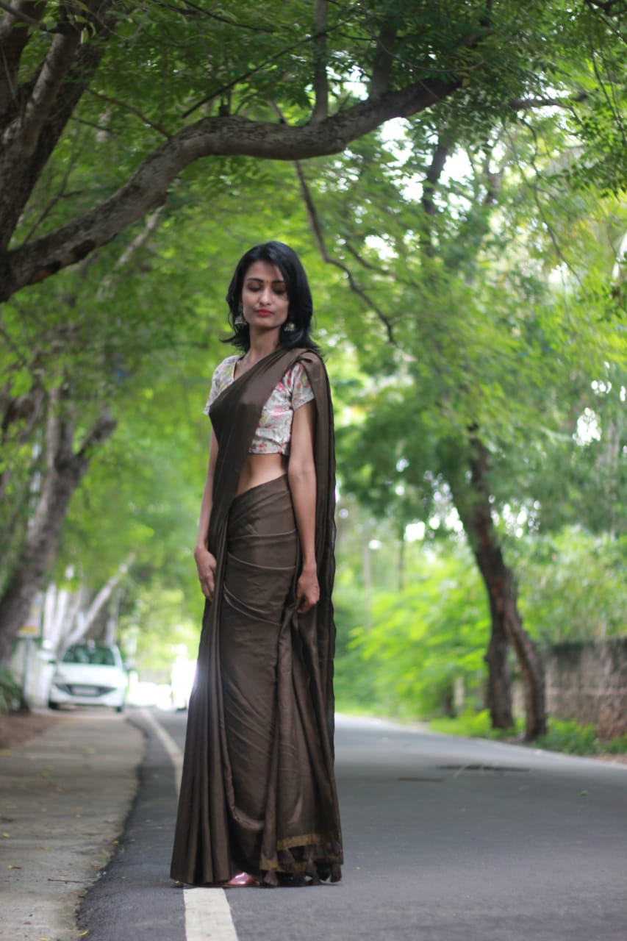
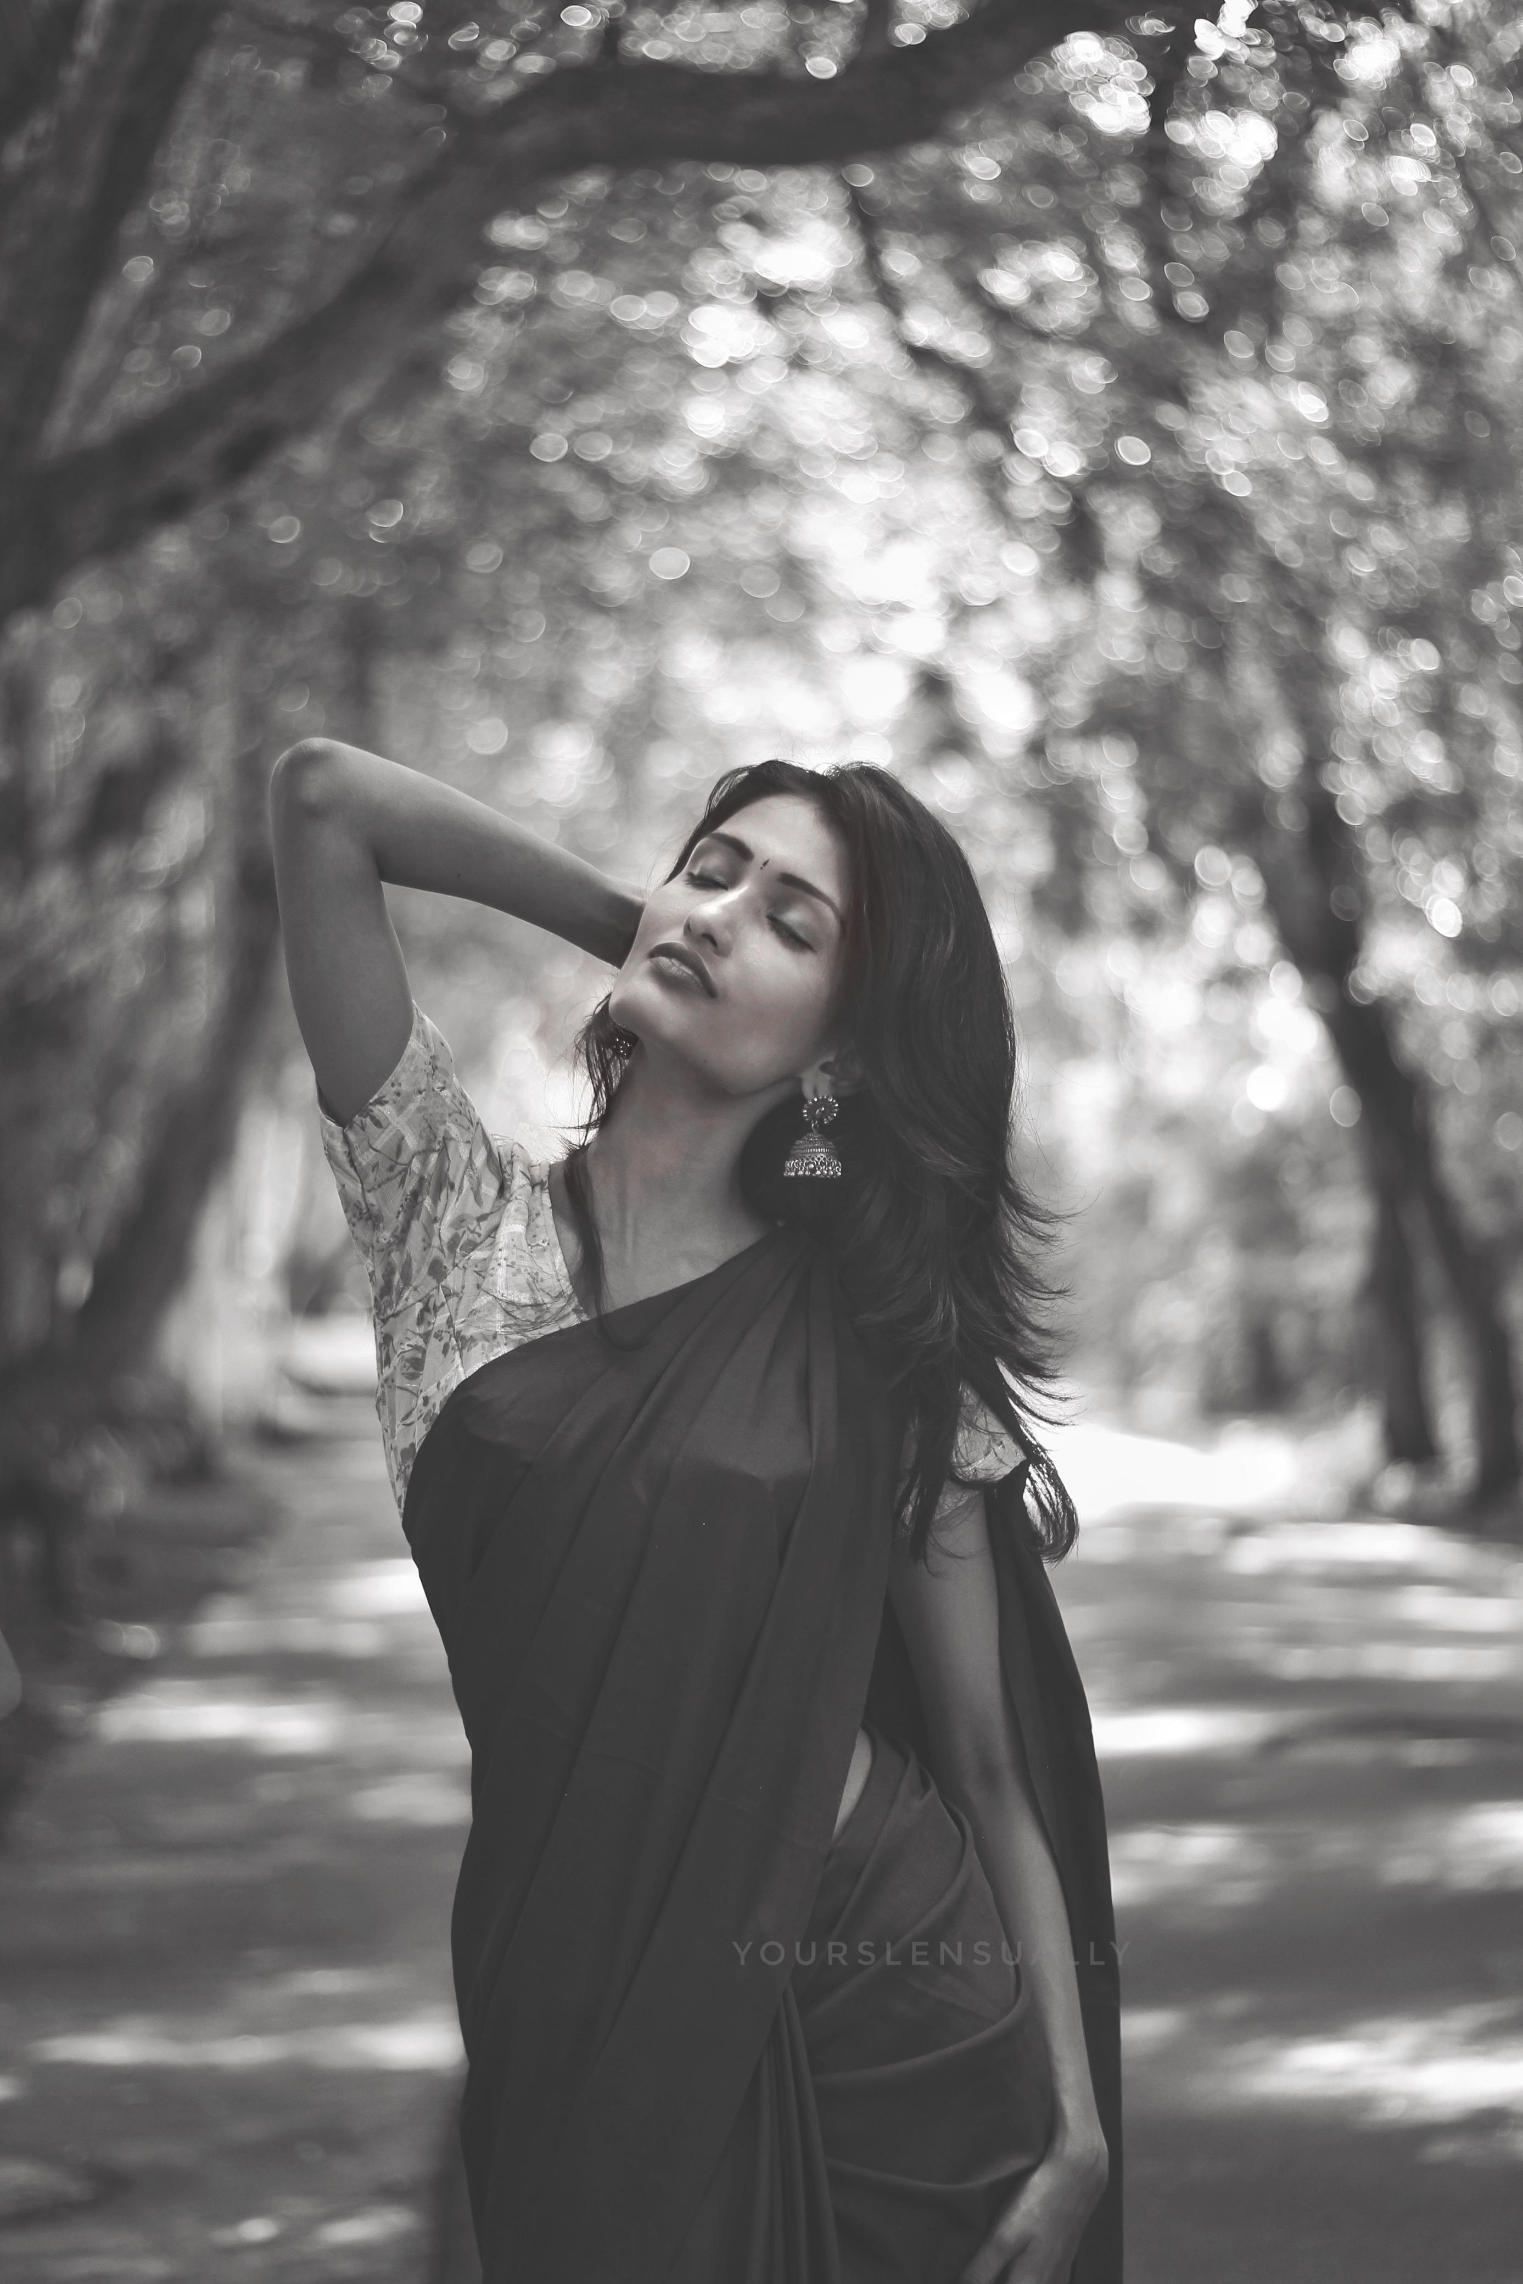
Age : 25
Height : 5.7 inches /170 cm
Weight : 44kgs
City : Chennai, Tamil Nadu

Slide 3
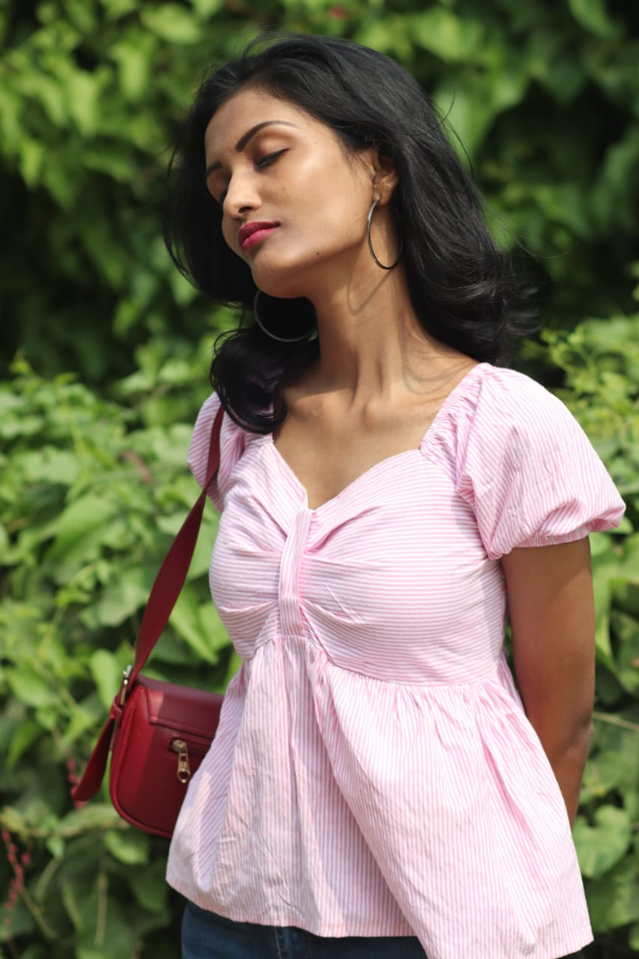
Measurements:
Bust : 32
waist : 28
Hip : 32
Other Details:
Skin Tone - Medium skin tone (Warm ivory)
Eye Color - Dark brown
Hair Color – Black
Shoe Size - IND 7
Marital Status: Single
Languages- , Tamil and English

Slide 4

Contact Details :
Contact no. : 8248725085
Mail I'd : iswarya.s.riya@gmail.com
Instagram profile:https://www.instagram.com/imyour.iswarya?igsh=aWNnYmFldzdjc3Ft

Slide 5
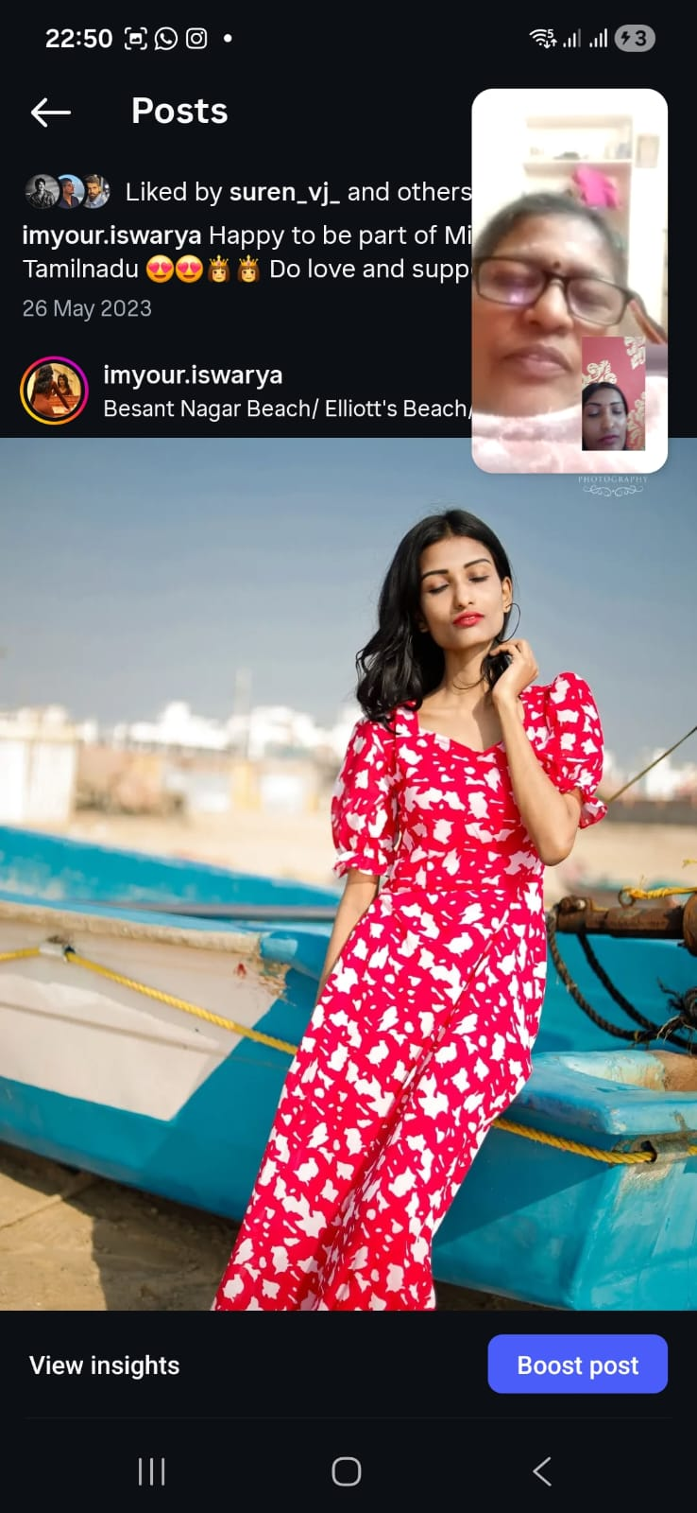
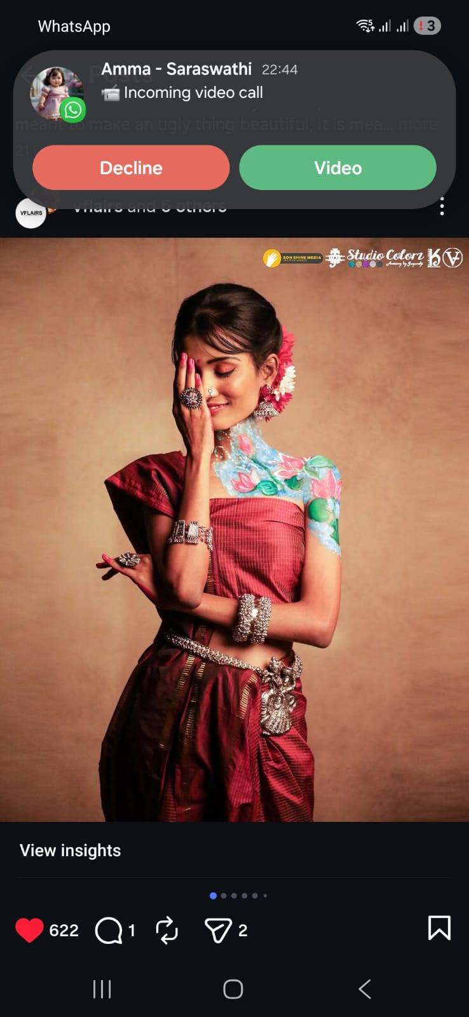
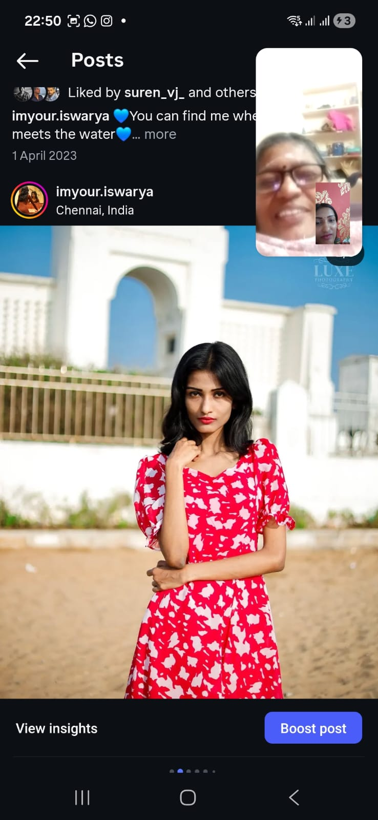

Slide 6
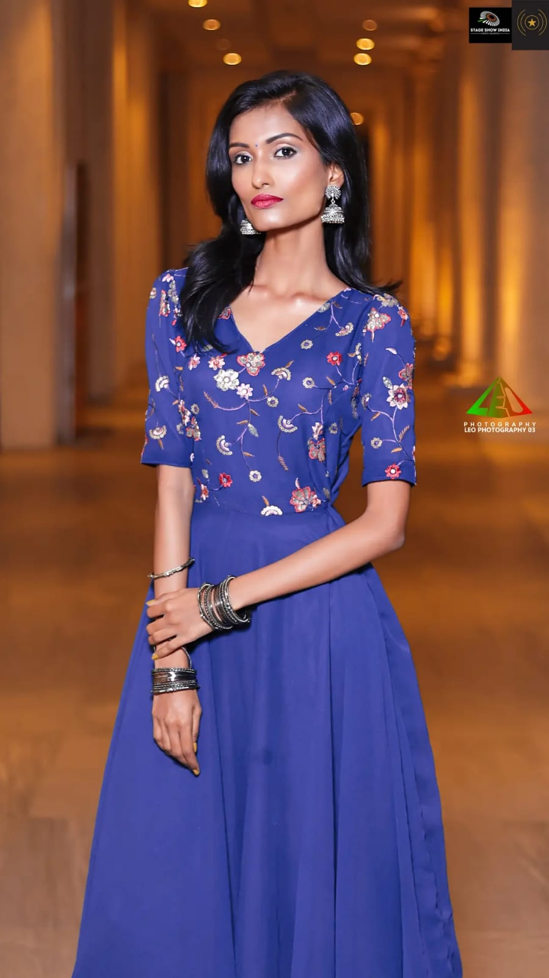
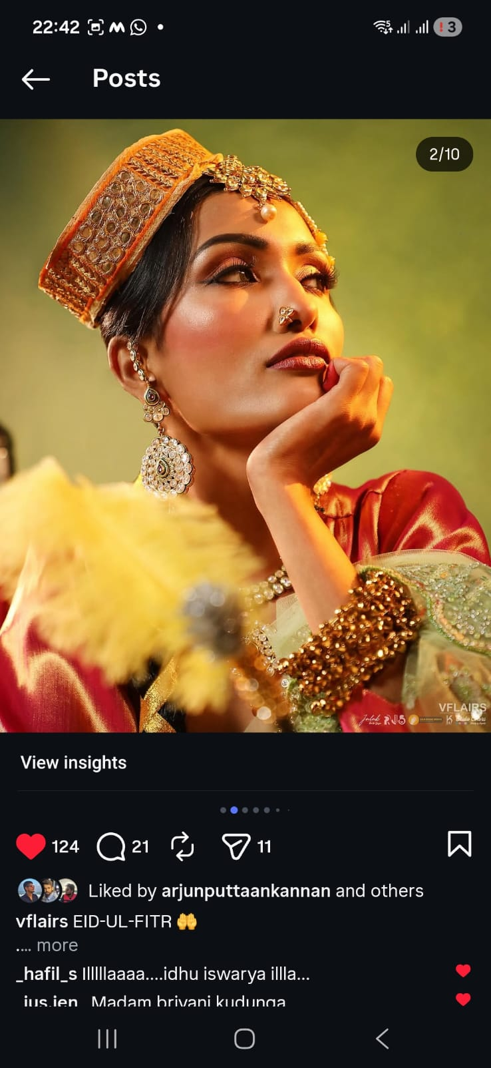

Slide 7
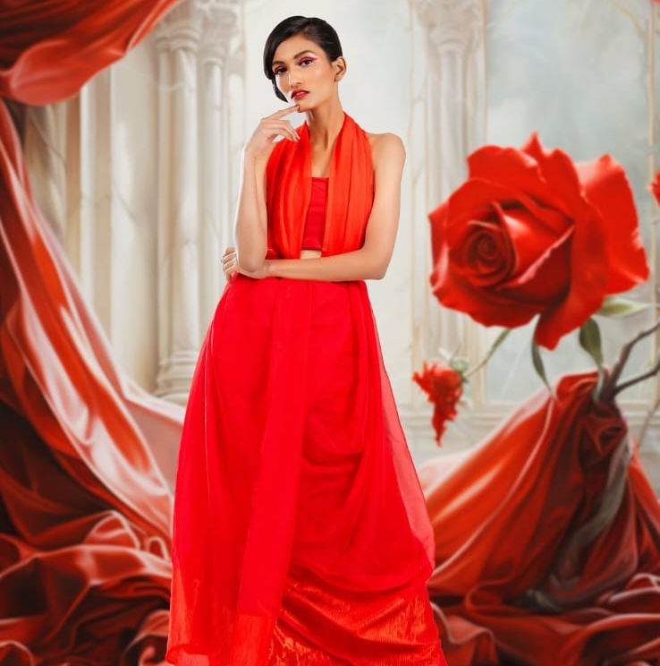
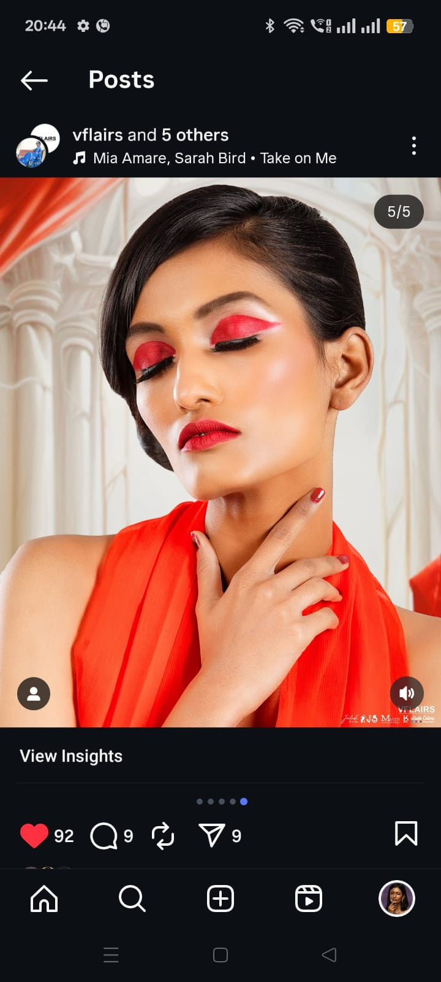

Slide 8
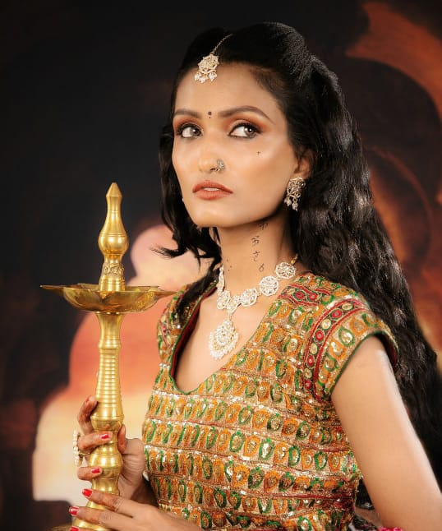
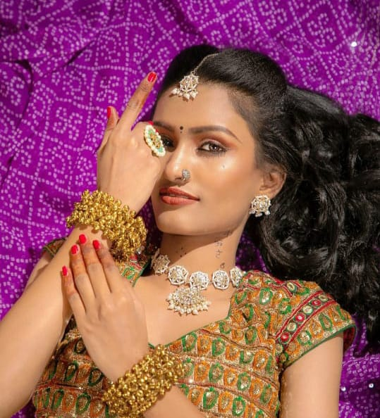

Slide 9
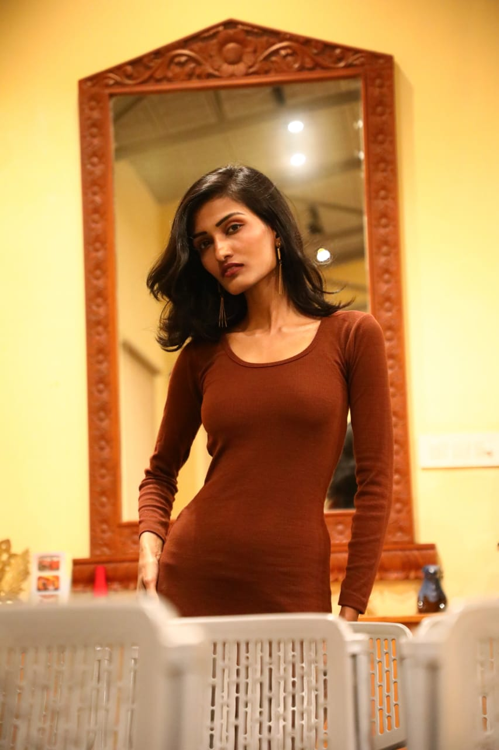
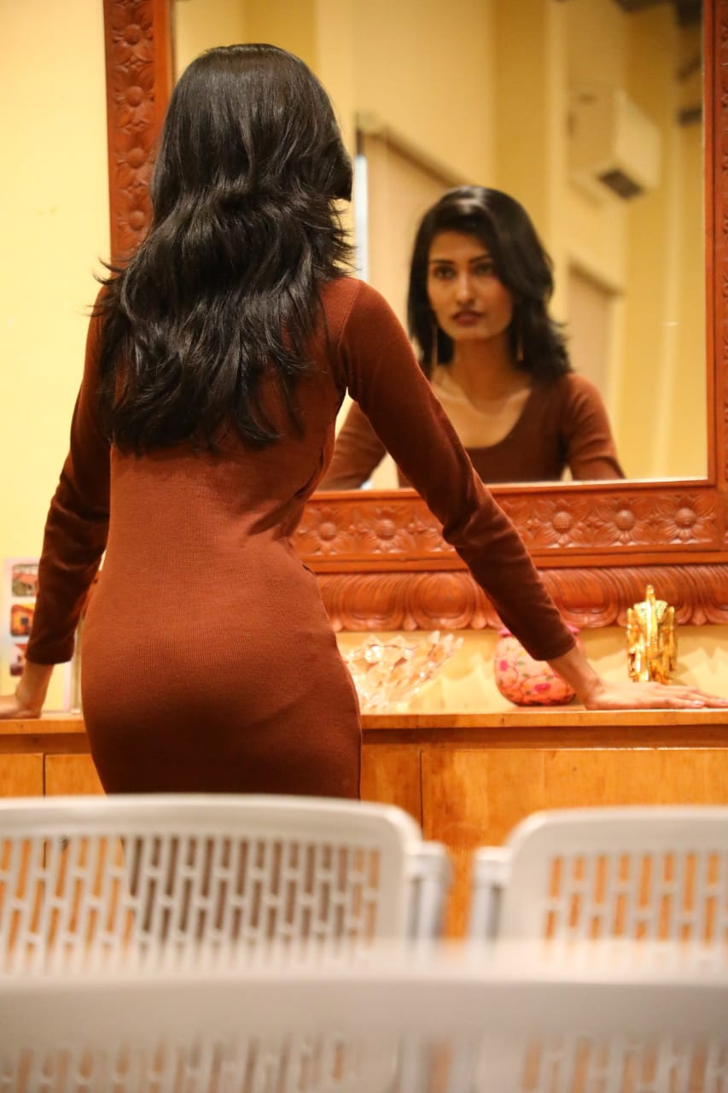

Slide 10
