Slide 1
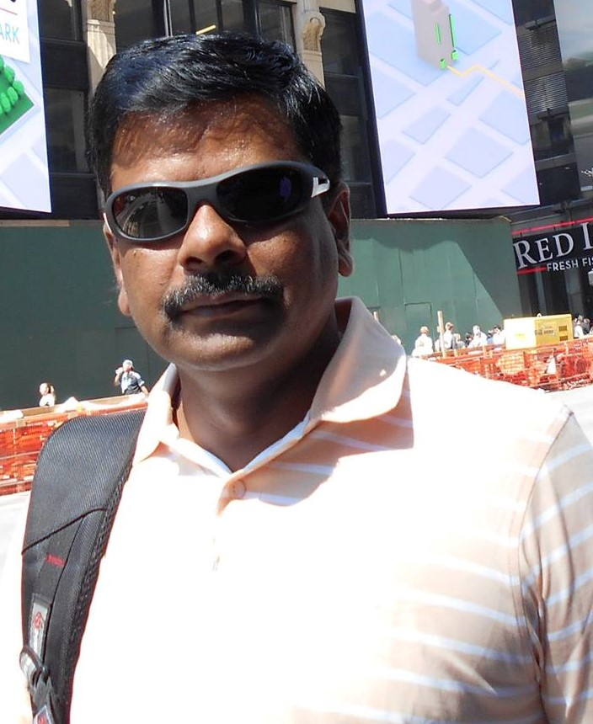
M J PROFILE
JAGADEESHA M
Mob-9344068909/8897233077 email-jaggisun@gmail.com
Blood Group:- O+ve
Height:-165cms
Eyes:- Black
Color:- Fair
Mother Tongue:-Kannada
Languages Known:- All South Indian Languages+ English and Hindi
Present Projects:- 3 Auditions Completed, Selected in 1 Project (Kannada Madhyama-Kalki Productions-Movie)

Slide 2
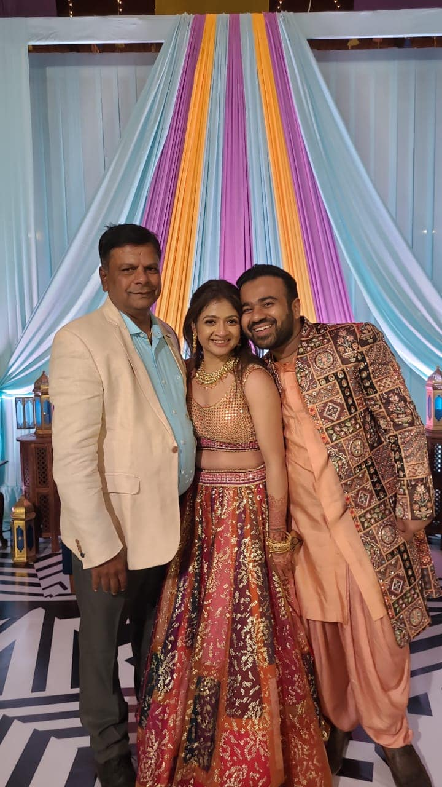
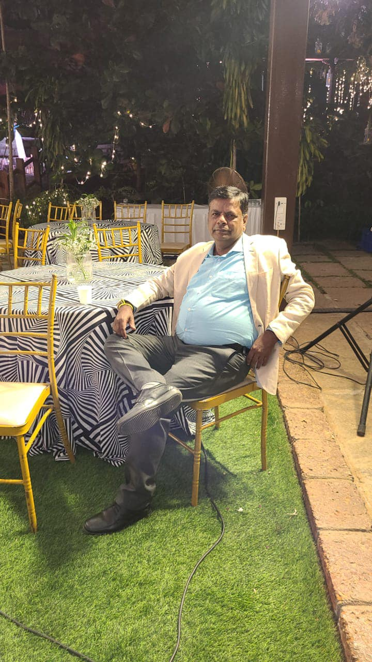
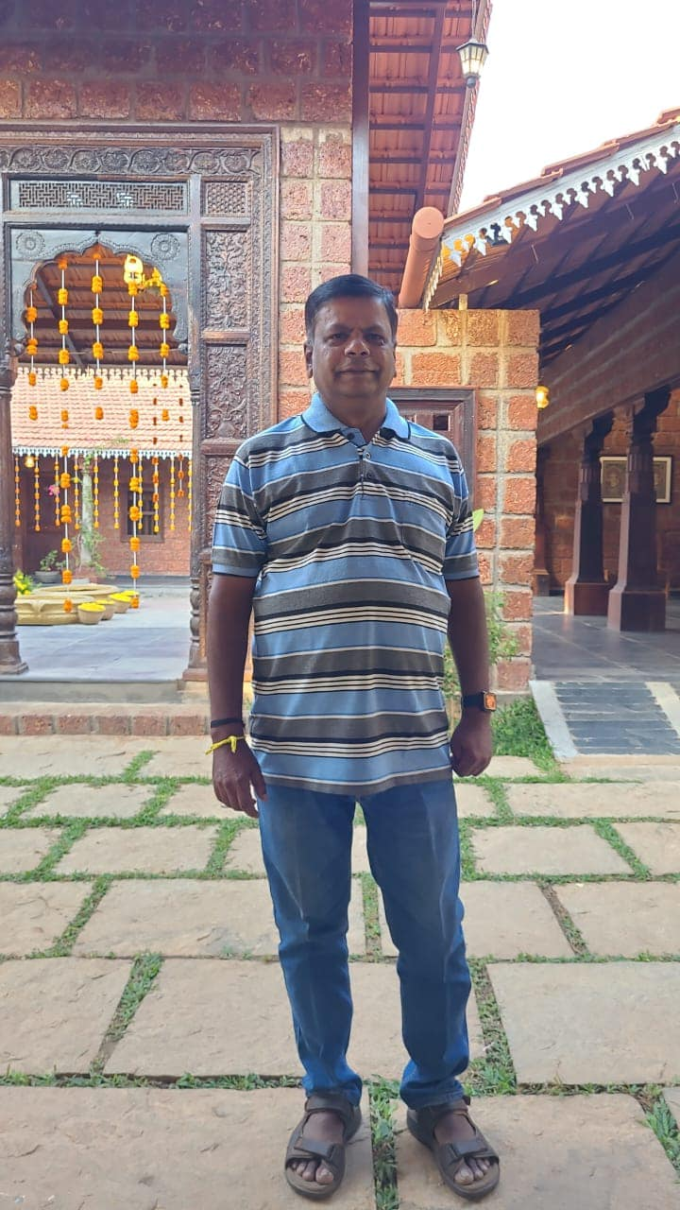

Slide 3
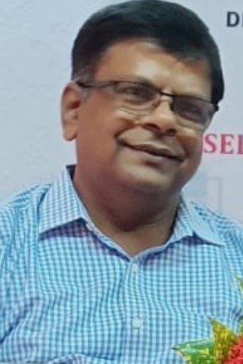

Slide 4
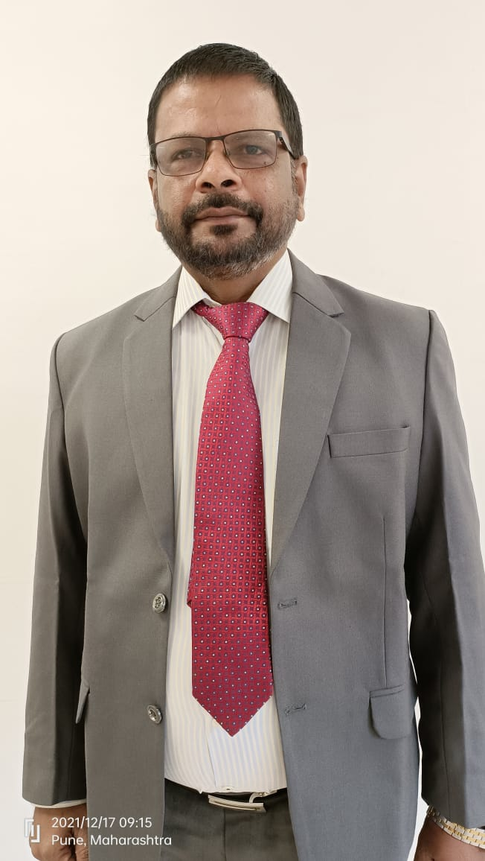
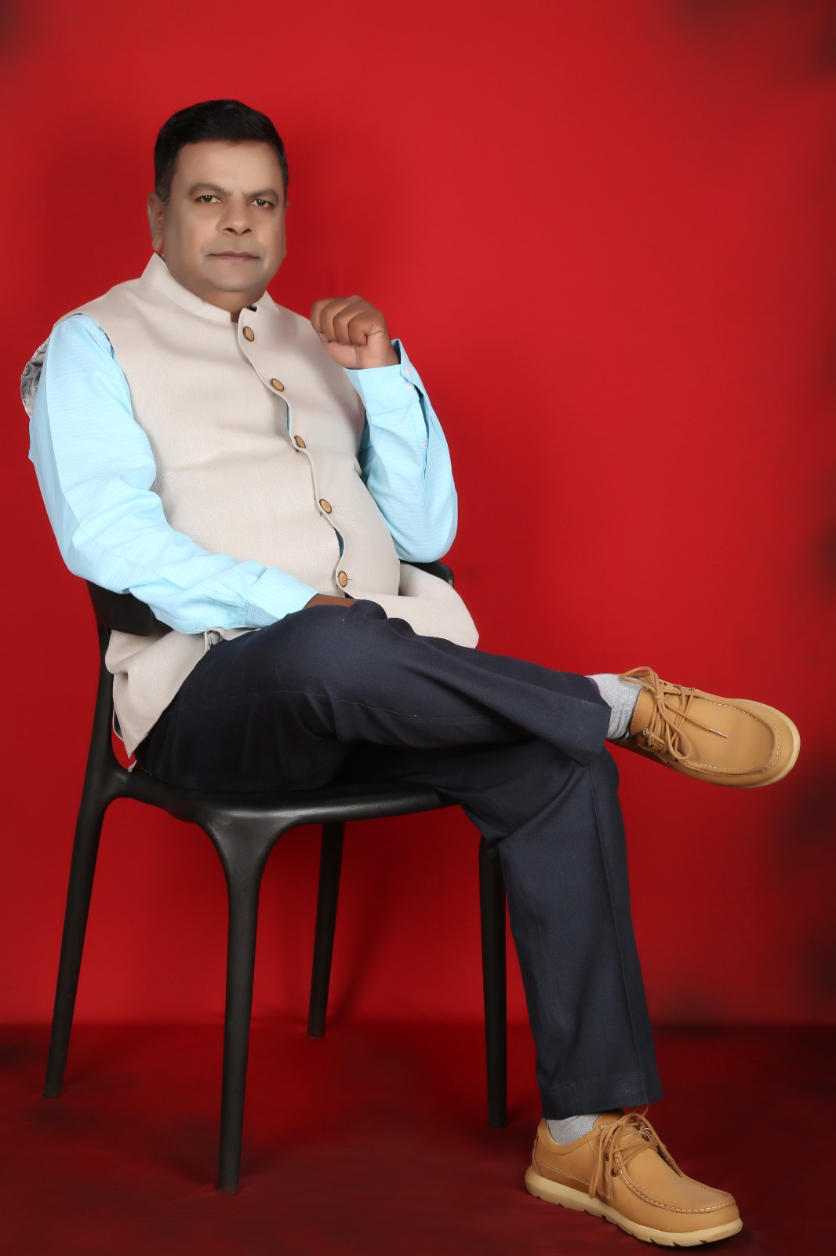

Slide 5
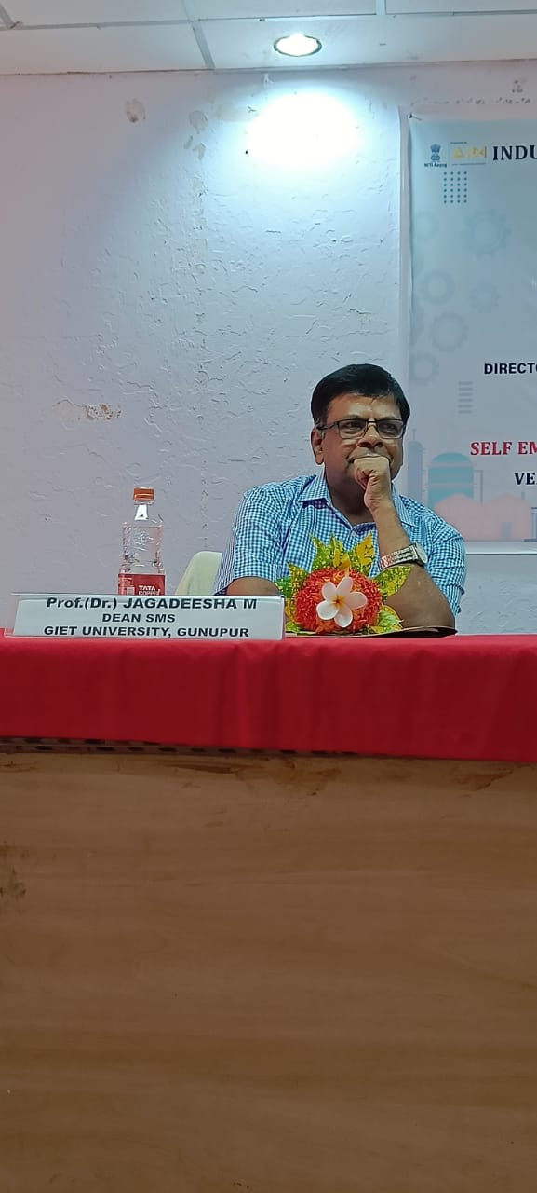
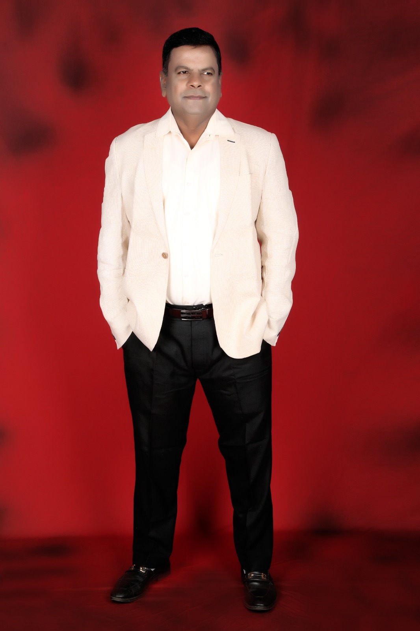

Slide 6
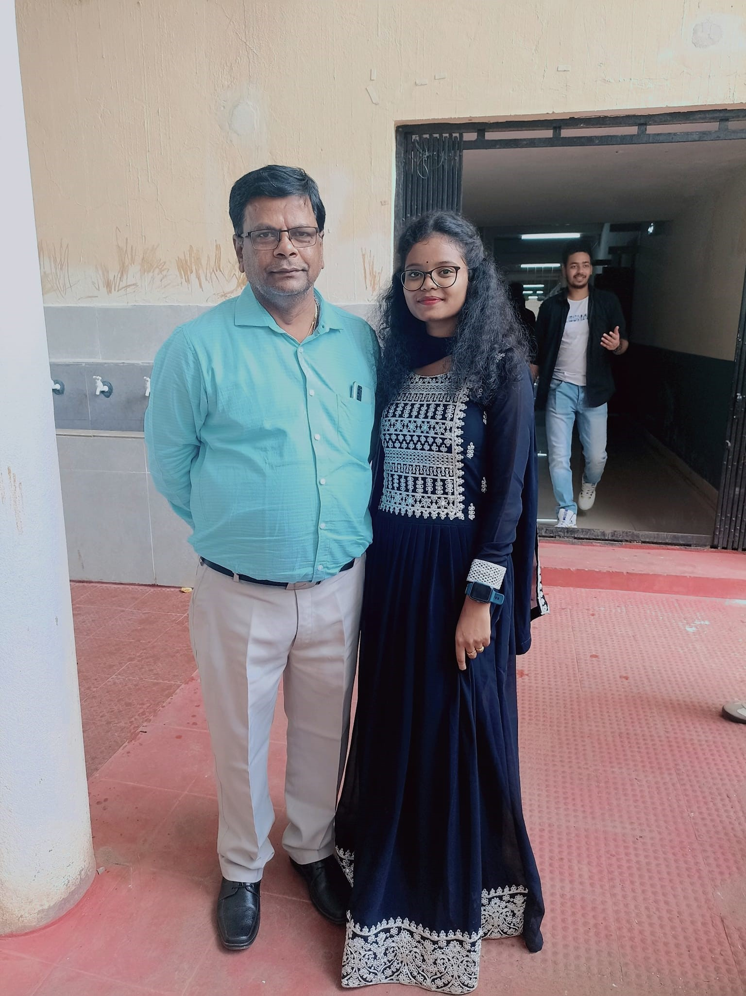
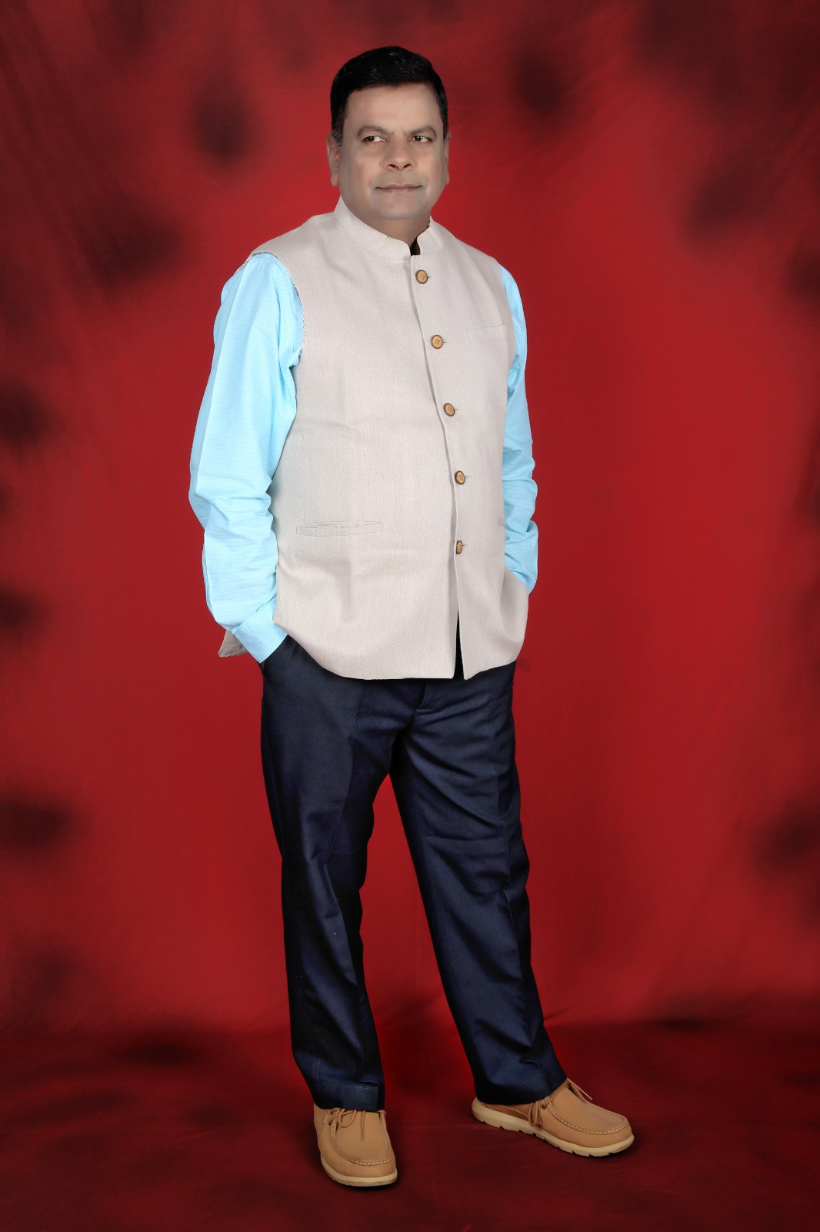

Slide 7
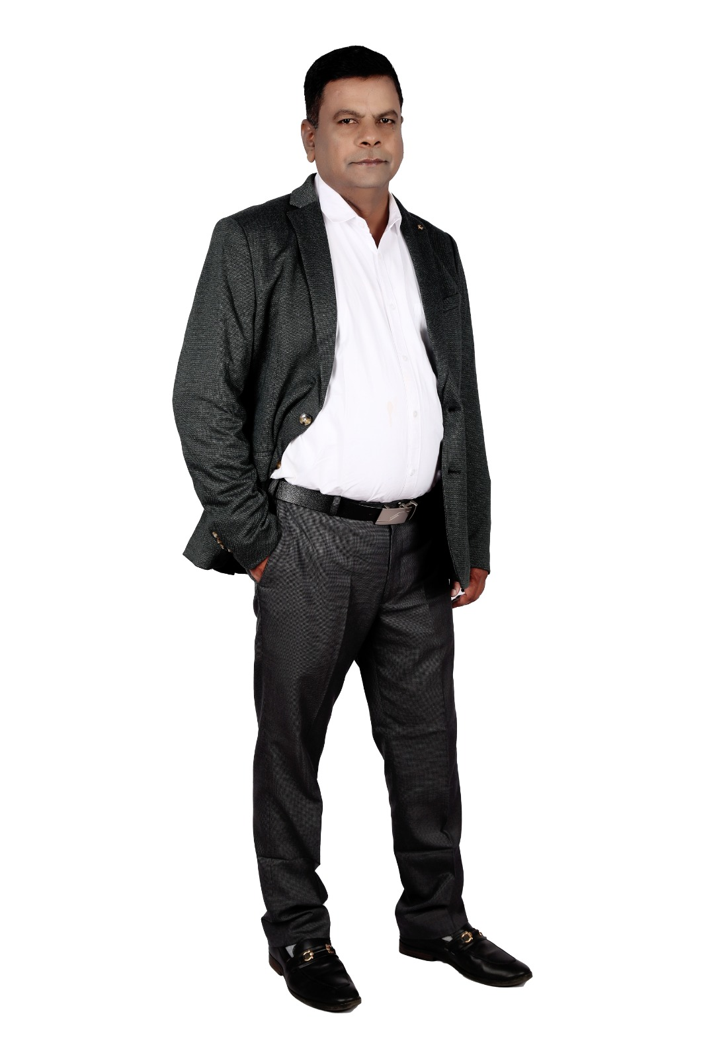
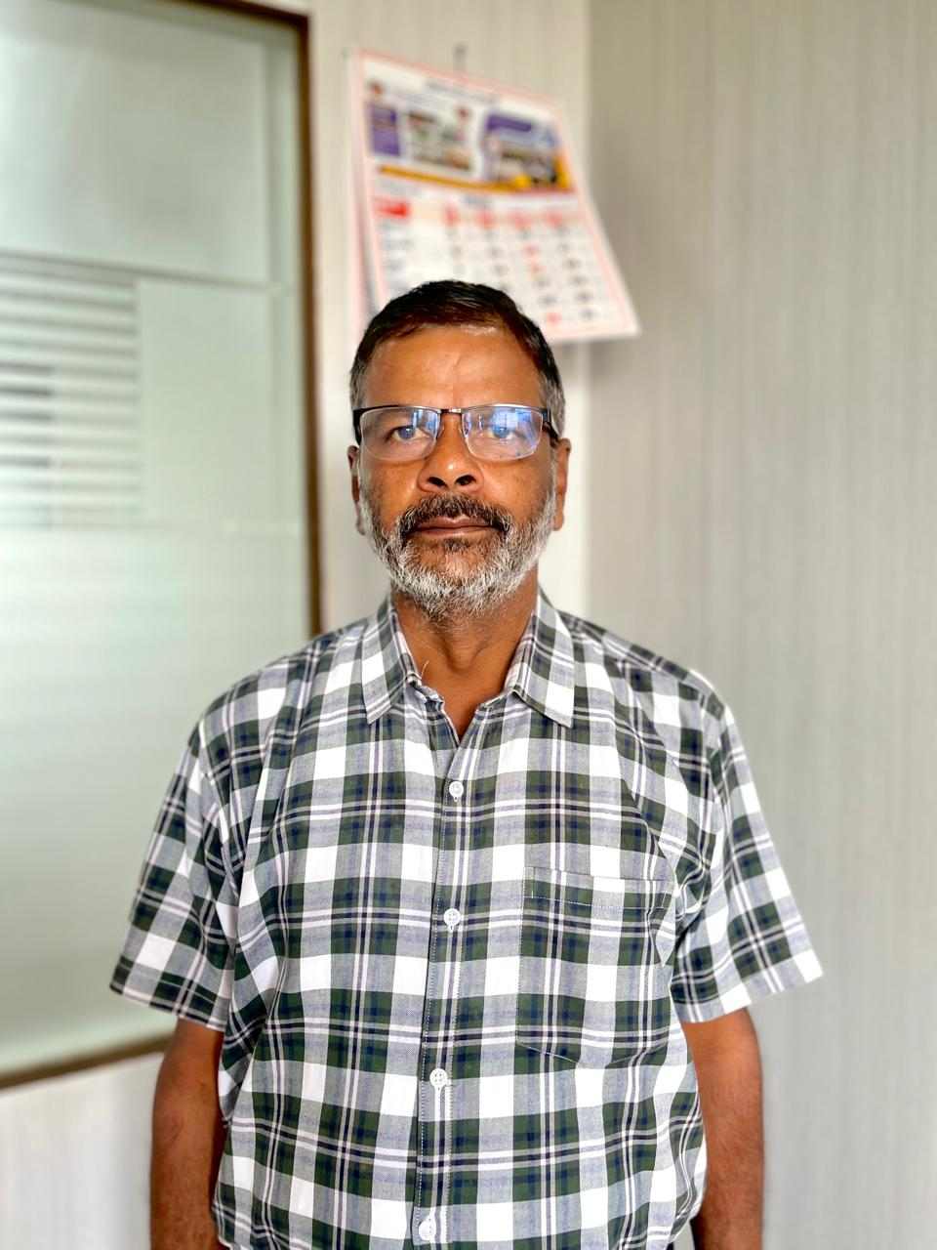

Slide 8
